Slide 1

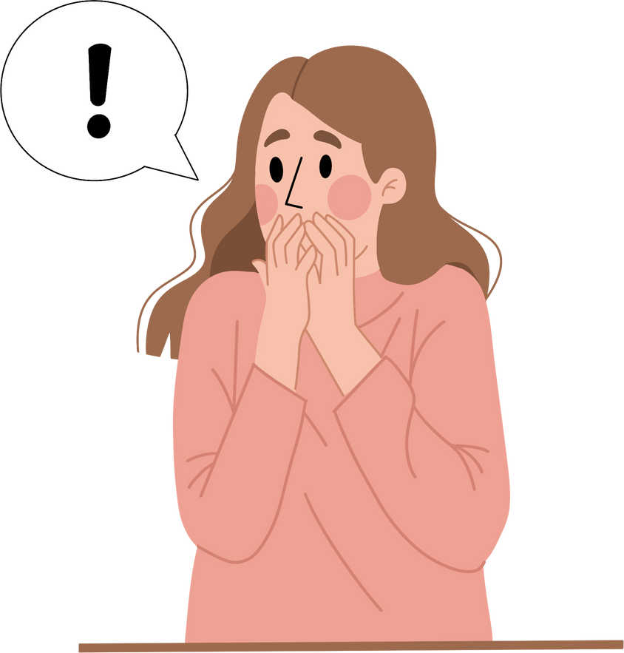
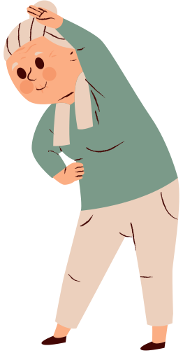

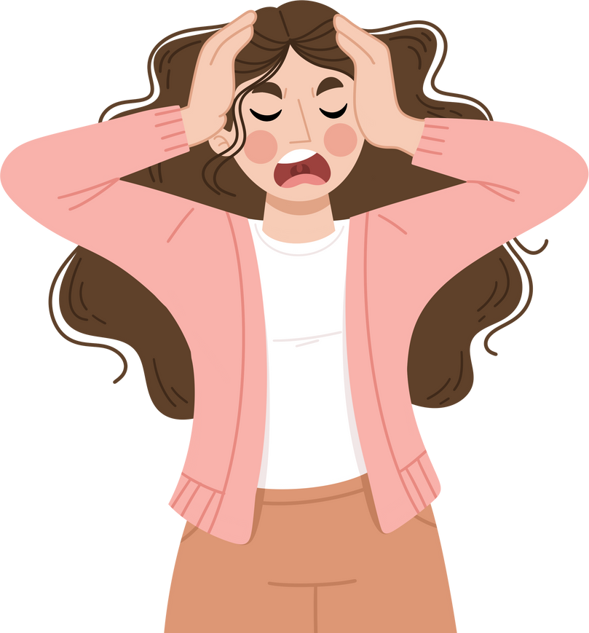
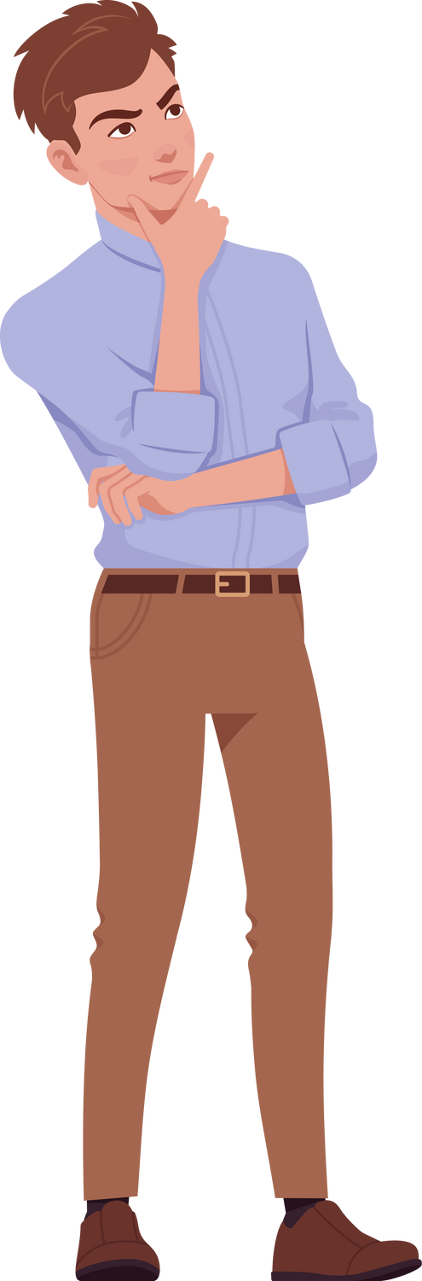
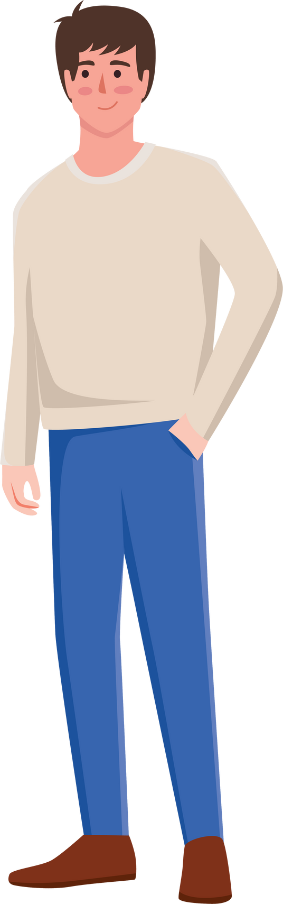
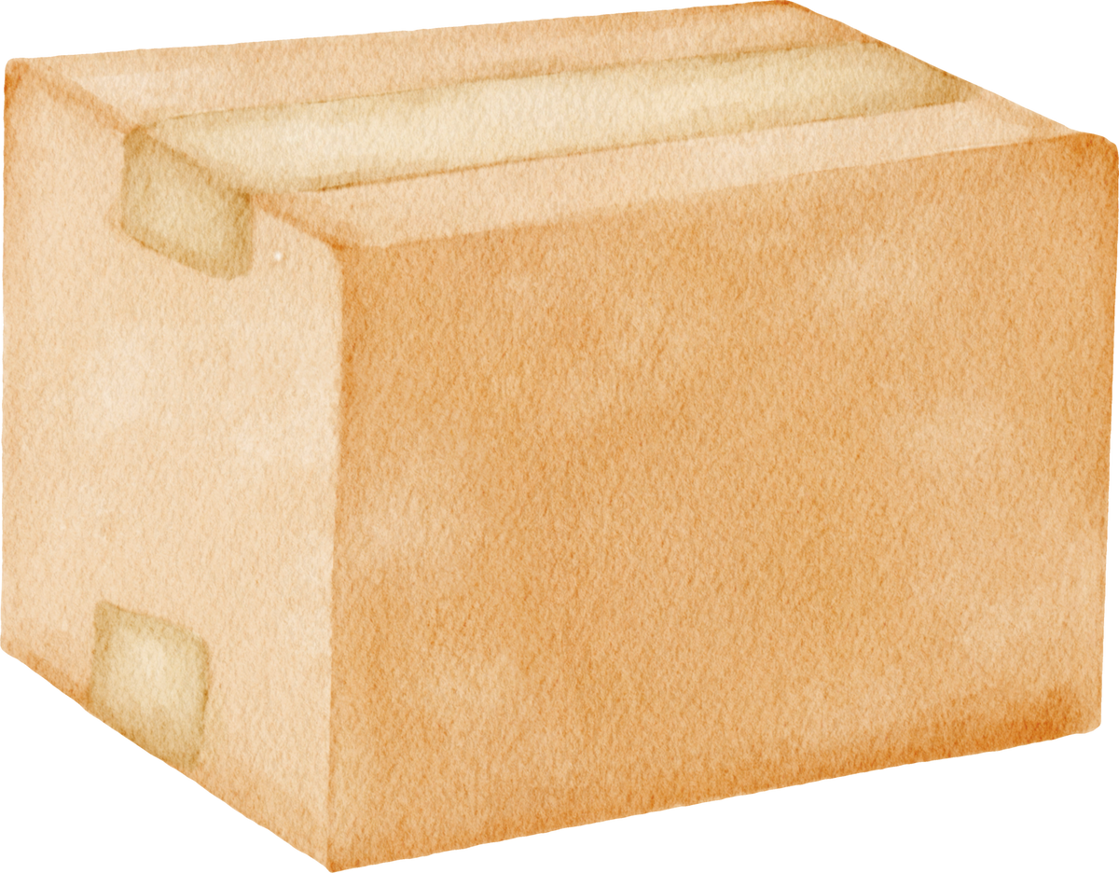
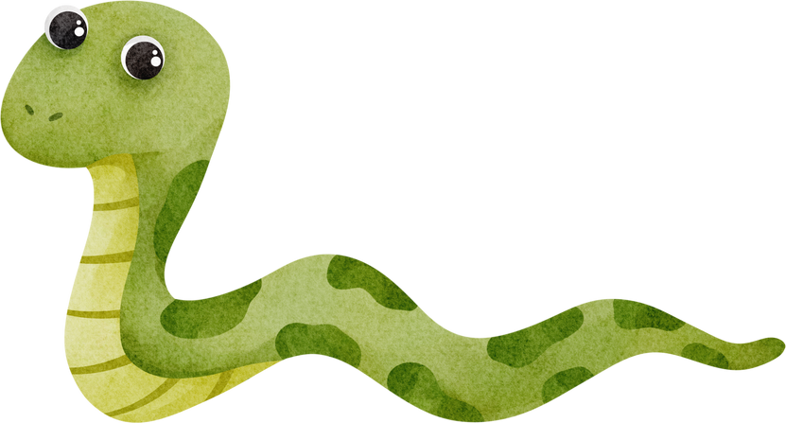
A2-B1
FLUENTLICIOUS
materials for language learning
Focus: family and emotions
Age group: teenagers and adults
Word count: around 500
The awkward gathering
A short interactive story for English learners

Slide 2
FLUENTLICIOUS
materials for language learning
Emma didn’t want to go to the family reunion - too many people, too many questions. However, her mom really wanted her to come as they haven’t seen each other for weeks! Emma arrived and opened the door.

Slide 3
FLUENTLICIOUS
materials for language learning
What do you think she saw when she opened the door?

Slide 4
FLUENTLICIOUS
materials for language learning
Grandma Rose was standing at the entrance with her hands on her hips. “You’ve grown so much! And… maybe gained some weight?”
Emma laughed nervously. “Hi, Grandma.”
In the living room, cousins ran around. Her uncle was asleep on the couch. The house was full of noise and hugs. Emma took a deep breath and tried to calm herself, after all, it was only for a day! Unfortunately, she had no idea what was coming…

Slide 5
FLUENTLICIOUS
materials for language learning
What do you think was coming?

Slide 6
FLUENTLICIOUS
materials for language learning
Emma was in the kitchen, trying to stay calm when suddenly the door opened. It was uncle Bob and he was holding… a box. Quite a big one!

Slide 7
FLUENTLICIOUS
materials for language learning
What do you think was in the bag?

Slide 8
FLUENTLICIOUS
materials for language learning
To everyone’s horror, he pulled out a long, green snake! Aunt Lisa screamed, a baby cried and Emma dropped her cup.
“Don’t worry,” said Uncle Bob. “He’s friendly.”
The snake stuck out its tongue. Grandma said, “Is that a belt?”
Everyone laughed—except Emma. She was frozen.

Slide 9
FLUENTLICIOUS
materials for language learning
Do you think others will have more surprises?

Slide 10
FLUENTLICIOUS
materials for language learning
The front door opened again. This time it was Cousin Mia and behind her, there was a tall man... and another man and then… a third man! Emma blinked. Grandma blinked. Even the snake looked confused!

Slide 11
FLUENTLICIOUS
materials for language learning
Who do you think were these men?

Slide 12
FLUENTLICIOUS
materials for language learning
“Mia said they were all her BOYFRIENDS!
“Boyfriends?” asked Uncle Bob. “As in… more than one?”
Mia laughed. “Oops! I didn’t think all of them would come!”
The boyfriends looked at each other. One crossed his arms. Another whispered, “Wait, what?” The third just turned around and walked away. Emma nearly choked on her drink. This was no longer a reunion. It was a reality show!

Slide 13
FLUENTLICIOUS
materials for language learning
What do you think they will talk about during the dinner?

Slide 14
FLUENTLICIOUS
materials for language learning
Dinner was… tense. The snake was now in a box (thank you, Aunt Lisa). The two remaining boyfriends sat far apart. Mia kept smiling like everything was fine until Grandma asked ...

Slide 15
FLUENTLICIOUS
materials for language learning
What did Grandma ask?

Slide 16
FLUENTLICIOUS
materials for language learning
“So, Emma… are you still single?”
Emma dropped her fork. “Uh, yes.”
“Why?” Grandma asked loudly.
Emma wanted to hide under the table! She got up too quickly, tipped the table and then suddenly the snake’s box moved and rattled and then fell down! The snake was loose again...

Slide 17
FLUENTLICIOUS
materials for language learning
How did everyone react?

Slide 18
FLUENTLICIOUS
materials for language learning
One boyfriend screamed. Another threw mashed potatoes. The potatoes hit Aunt Lisa. She screamed loudly. Grandma fell asleep in her chair.
Emma just sat there. She couldn't decide: laugh or cry? Emma just wanted to run away... she pulled out her phone and texted her best friend:

Slide 19
FLUENTLICIOUS
materials for language learning
What did she write?

Slide 20
FLUENTLICIOUS
materials for language learning
She texted: “HELP. Snake. Potatoes. Too much. SAVE ME”
Unfortunately, her friend didn’t offer a rescue mission and only laughed at her. Emma was thinking about running away through the bathroom window... She looked around the living room and saw the chaos and madness. She smiled... after all, it was her family. She sat down, picked up a cookie, and joined the madness.

Slide 21
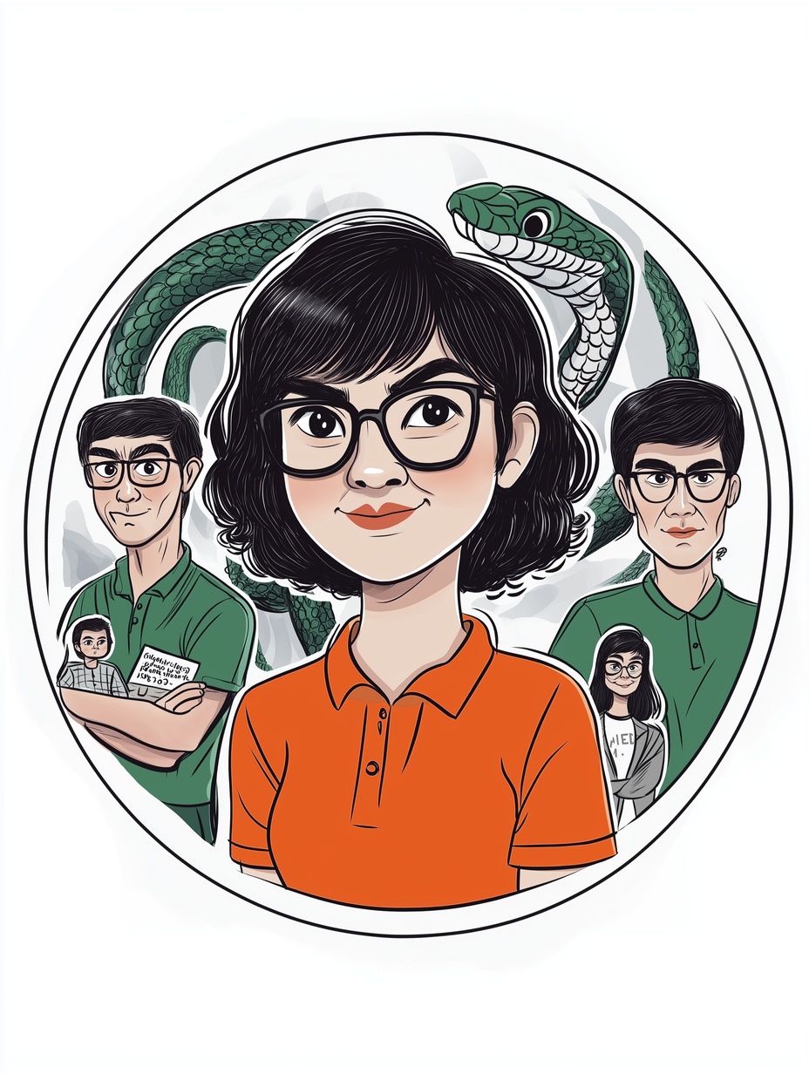
FLUENTLICIOUS
materials for language learning
The end

